Slide 1
History of the NFSA Nitrate Collection
1935 - 2001
Ray Edmondson
ray@archival.au

Slide 2
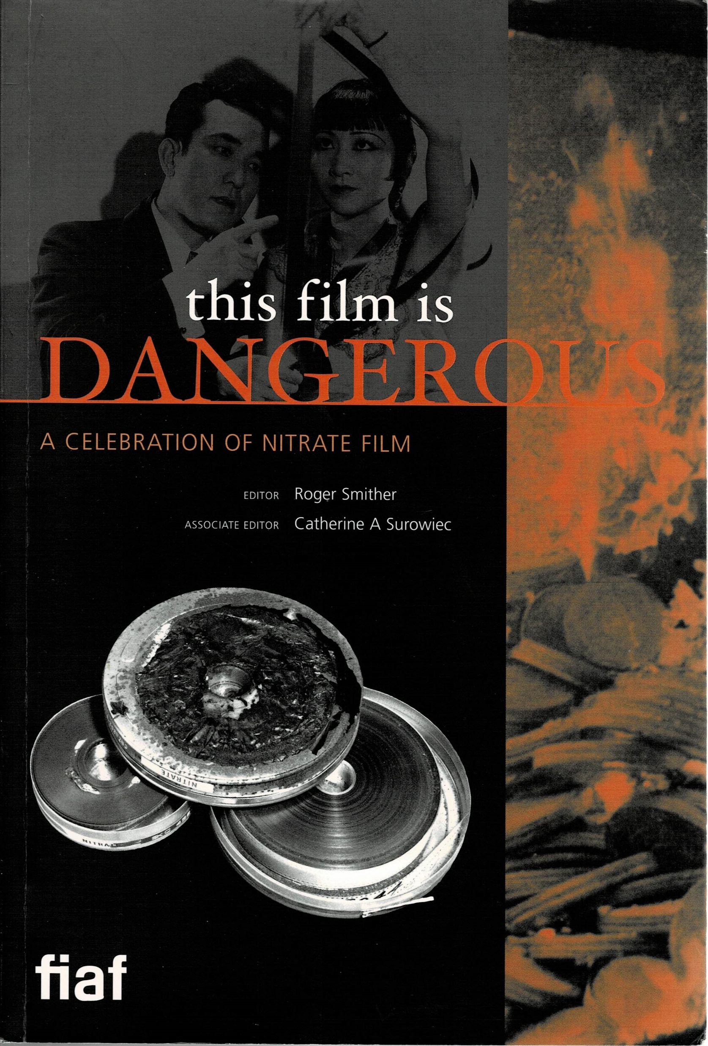
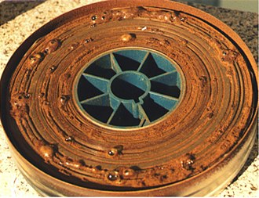
What is nitrate film?
Notes:
35mm Cellulose nitrate film stock was the original workhorse of the professional film industry because it was tough and durable and had excellent optical qualities. But is it also highly flammable and is subject to decomposition and needed to be stored and handled accordingly. It was eventually phased out during the 1950s in favour of “safety film” – cellulose triacetate. This meant that nitrate prints and negatives were then progressively discarded by the industry and destroyed or gravitated film archives.
The silver rich black and white emulsions, and the pioneering colour processes of the pre-1950 period have a beauty of their own when projected, which specialists claim can never be fully captured in photographic or digital copies. Although copying their content for preservation is an essential archival step, so is the retention of the original artefact for its life which – under the right storage conditions – we now know has no defined outside limit.
The FIAF book is in every way a weighty tome – stories of finds, destruction, appreciation from all over the world. Entertaining and emlightening!

Slide 3
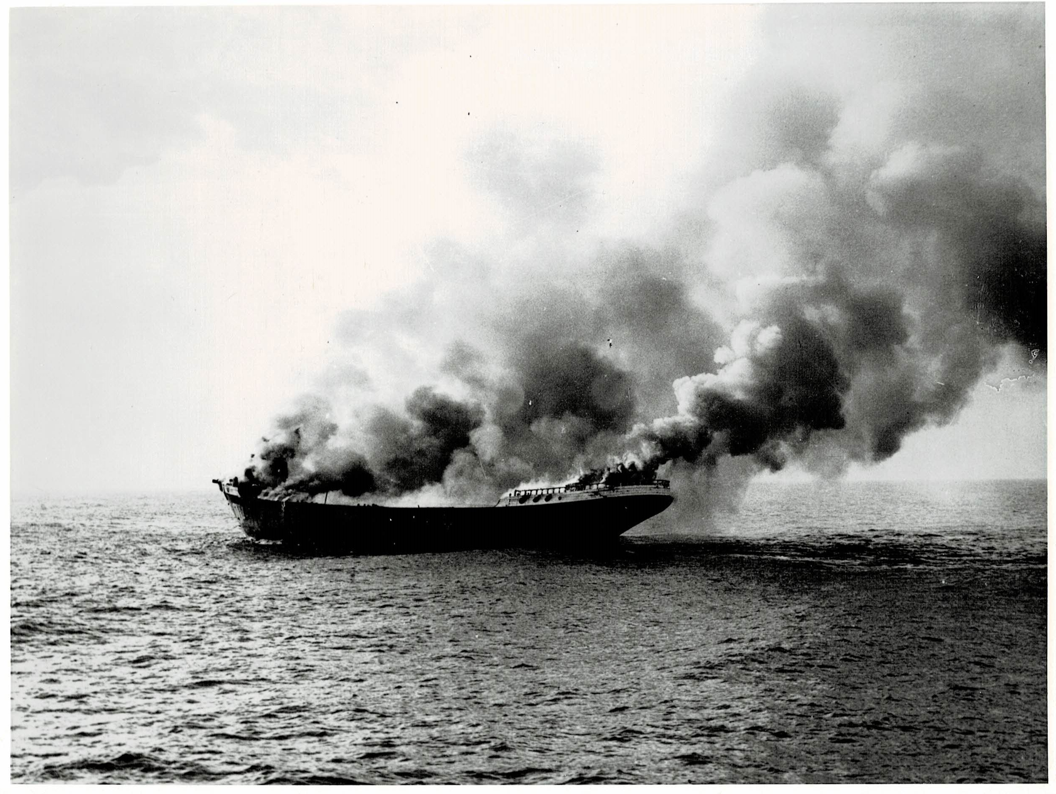
For the Term of His Natural Life (1927)
Notes:
This unforgettable scene from the epic For the Term of His Natural Life is of a significant part of Australia’s film history going up in smoke. Australasian Films solved a storage problem by loading an old hulk with tons of nitrate film and dynamite and towed it outside Sydney heads for the big scene. What was in the blaze? Undoubtedly lots of newsreels – weekly issues of the Australasian Gazette, of which there are now few surviving examples – but also feature films and documentaries. Mythology surrounds the event – what did collectors quietly remove in the dark, the night before this scene was shot?

Slide 4
1935-39: National Historical Film and Speaking Record Library
Joint operation: Department of Commerce Cinema Branch /Commonwealth National Library
Contemporary with first film archives in UK, France, Germany, USA – the founding members of FIAF in 1938
Nitrate collection held in Melbourne
Nitrate was then industry standard
Structures upset by WW2
Notes:
The first institutional film archives were set up in the 1930s in response to the wholesale destruction of silent films which began after the industry began converting to “talkies” – sound films - in the late 1920s.
The predecessor of today’s NFSA was established by Federal Cabinet in 1935 as a joint undertaking between the Cinema Branch of the Department of Commerce (the government film unit of the day, and the forerunner of Film Australia) and the Commonwealth National Library (forerunner of today’s National Library of Australia). It was created in December 1935, and announced in February 1936 when the Minister for Commerce, Earle Page, declared that Australia would “come into line with other progressive countries, chiefly Great Britain and the United States and other European countries.”. That’s the formal explanation, but the real influencers behind the scenes were Lyn Maplestone, head of the Cinema Branch, who had already built the nucleus of the collection, and Kenneth Binns, head of the Commonwealth National Library, who, with his family, was a regular patron of Canberra’s Capitol Cinema at Manuka.
Unfortunately we are now uncertain about what that pioneering collection contained. The original card catalogue is now lost. Acetate film, about 80% of the collection, was stored in Canberra. The nitrate component was kept with the Cinema Branch in fire designed storage in Latham House, Melbourne.
World War 2 disrupted many things. Activity faltered and the Cinema Branch itself was wound down. Lyn Maplestone passed out of the picture, and soon after the War, Kenneth Binns retired to be replaced by Harold White.

Slide 5
1946-50s: The CNL Film Division
Popularisation of 16mm safety film for non-theatrical use
Launch of the federal free film library network
Creation of the Commonwealth National Library Film Division – a lending operation, not an archive
1951 onward: film industry phases out nitrate
1953: Nitrate film arrives from Melbourne – storage becomes an issue
Larry Lake is Division Head – 1953-56
Notes:
So much had changed by the time the War ended.
The non-flammable ‘safety’ 16mm gauge had been popularised during the War, and in 1946 a national government-funded free film lending library system was established. The Commonwealth National Library’s new Film Division was set up in that year, and designed as the anchor of the federal network. Its initial staff of 3 included a young Rod Wallace, recruited as a cataloguer. But this was a film lending service, not an archive. It was not a revival of the pre-war Film and Speaking Record Library. In fact the NFSA’s 16mm non theatrical collection today is a surviving remnant of this system.
It is presumed that the Film and Speaking Record library’s acetate collection gravitated to the custody of the new Film Division. Some of its nitrate collection certainly did: in 1953, following a fire at Latham House, two boxes of nitrate film arrived in Canberra…..presumably all that was left! The contents included an 8 reel print of The Sentimental Bloke. Film Division head Larry Lake recognised its worth and sent it to Automatic Film Laboratories in Sydney for copying.
Of course, the Film Division lacked fireproof storage for nitrate, so it had to seek alternatives. These turned out to be old powder magazines and bunkers

Slide 6
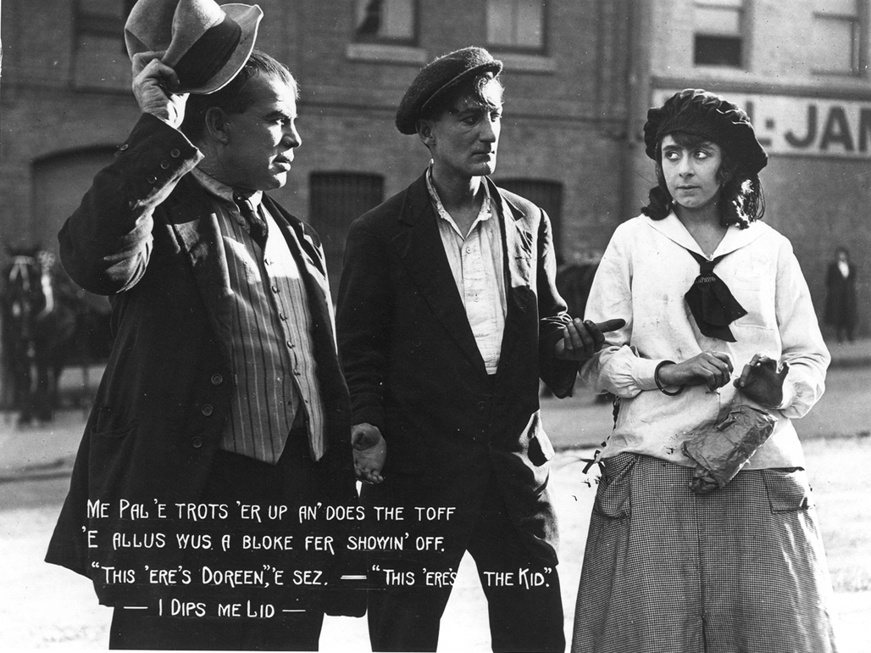
1954: The Sentimental Bloke (1919)
“Sitting on the floor was a pile of rusting cans. I was told it was some very old film, nothing very interesting. It was a job that had been waiting, that no one wanted to do. It was obviously nitrate film for it stank to high heaven. I was about to begin a journey into Australian film history”.
Anthony Buckley: Behind a Velvet Light Trap p 17
Notes:
In his first job at Automatic Film Laboratories, a 16 year old Anthony Buckley was assigned the task of repairing and resplicing the print of The Sentimental Bloke prior to copying. He discovered that although the film was silent, it was not black and white: each scene was tinted a different tone, hence the number of joins as each tint was separately developed in the laboratory baths and inserted in the correct sequence in the reel.
From the main titles Tony realised it was an Australian feature film. He asked around. No one knew anything about it, or had ever heard of Raymond Longford. As he was re-splicing the old hand-made joins, Tony saved the frames from either side of the join, putting them in envelopes to take home each day – and thereby keeping a colour record of the film, because the duplicate negative made from it would be black and white.
This was the beginning of Tony’s life long connection with what would became the NFSA, as well as of his passion for Australian film history. He would become a significant figure in the film industry’s rebirth in the 1970s.

Slide 7
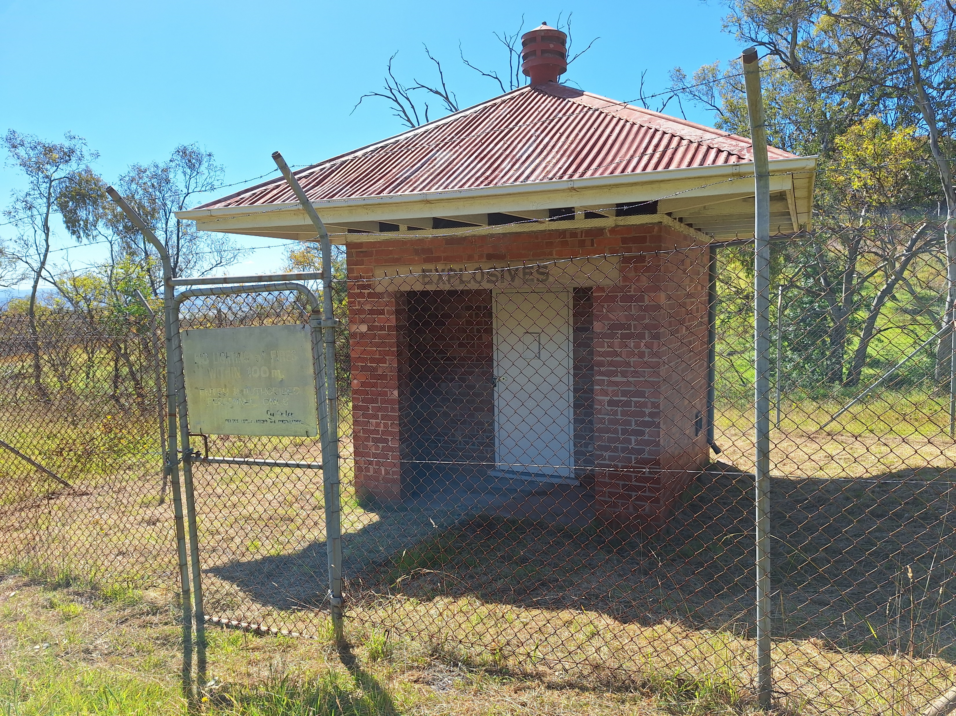
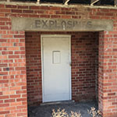
1950s -1960s: Seeking and storing
Rod Wallace is Division Head 1956-66
Begins active nitrate film search in spare time
Storage expedients: Mugga quarry and following
Nitrate life uncertain: copying begins as funds allow
Library policy: copy to 16mm then destroy nitrate
1957: Commonwealth National Library splits into three; Films stays with National Library of Australia
Notes:
In 1956 Rod Wallace took over as head of the Film Division after Larry Lake was posted to London as the Library’s liaison officer. He began to campaign by mail seeking old film: writing to probate officers, town clerks, fire brigades. It was done at night, in his own time: running the film lending collection necessarily dominated his working day. As the collection grew, it was stored in an old explosives depot in the bush near the Mugga quarry – this one. It’s still there in an area of bushland called Callum Brae. One year it miraculously survived a bushfire which burned right up to its walls. When the collection had to be moved on, it was shoehorned into another explosives shed at a quarry at O’Connor Heights, This was followed by an ammunition shed at Duntroon Royal Military College, then a wooden shed at Harman Naval Base - and finally a purpose built bunker belonging to the Australian War Memorial, in which the Library was a tenant.
As the life of nitrate was considered uncertain, copying to triacetate at a commercial laboratory was done as funds allowed. It was expensive, and the bean counters necessarily compared it to the cost of books, so it became Library policy to tender for the cheapest work, reduction copy the 35mm to 16mm, and then destroy the nitrate original because of the storage problem. Silent films were copied through standard sound gates, thereby impairing image composition. In those restricted circumstances it was trading off quality against quantity in a race against time.
In 1957 the Commonwealth National Library was split into three parts: today’s National Archives, the Parliamentary Library and a (smaller) National Library of Australia. The intense politics resulted in the Film Division being allocated to the National Library rather than becoming another separate entity, as advocates wished.

Slide 8
1950s-60s: Cultural cringe
Moribund film industry and a cultural disregard for our history Australian film history
Film Division joins FIAF in 1958
Supporters and enthusiasts grow
Collectors cooperate
Acquisitions include Corrick Collection, early Chauvel films, Robbery Under Arms, On Our Selection
Notes:
Let’s recall the context in which Rod Wallace and others were working. It was the era of the cultural cringe. Launched in 1956, television was dominated by American content. The Australian film industry was moribund. Both inside and outside the National Library, many regarded film preservation as an expensive activity of dubious value. Rod recalled “in the early days we were regarded as nuts and were told so on many occasions. I’ll never forget the time a theatre full of film industry people watched a program of films we had recovered and then one man told me we should have thrown the lot on the tip. And the others agreed with him too.”
Larry Lake, as the Library’s London liaison officer - and father in law of future famous historian Marilyn Lake – had a wider sensibility. He had searched out Raymond Longfond and he took a 16mm print of The Sentimental Bloke to London to screen Australian House. He made contact with Ernest Lindgren, head of the British National Film Archive and established a connection with FIAF. The Film Division was admitted to FIAF membership in 1958. While the National Library enjoyed the exclusive status this brought – only one member per country was allowed at the time – its capabilities and practices did not match FIAF standards.
Rod Wallace’s work had nevertheless built a circle of supporters and enthusiasts. These included private collectors of nitrate film, who operated in a kind of twilight world because they held prints that were legally the property of distribution companies – surplus copies that had been officially, thought not actually, destroyed. They were reluctant to deal with government bodies like the Library. But it was through them that many of our most important silent films survived – such as On Our Selection and Robbery Under Arms. During the 1960s acquisition began on the Corrick Collection and the early Chauvel films. As an alternative to acquisition, collectors would sometimes lend a nitrate film for copying on the basis that when it was returned it was accompanied by a free 16mm print from the new dupe negative which the Library had made for preservation.

Slide 9
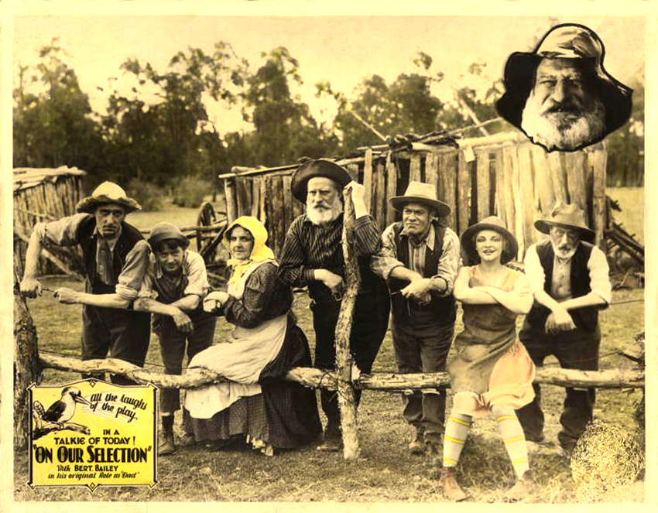
1962: The Cinesound Heist
“I went home that evening and it suddenly struck me what I had done. An entire studio’s output from 1931 to 1946 was on an anonymous grey truck travelling to the nation’s capital and no one had been told or given the opportunity of giving approval.“
Anthony Buckley: Behind a Velvet Light Trap p 17
Notes:
After Automatic Film Laboratories, Tony Buckley had worked for a time at Cinesound. He had discovered the studio’s neglected nitrate collection stored behind the projection box. It included Ken Hall’s feature films of the 1930s, partial prints of For the Term of His Natural Life and Adorable Outcast, and much more. He had sought permission to rewind, clean and repair them in his spare time – one reel at a time during his lunch break. After some years away, he returned in 1962 to become editor of the Cinesound Review, and discovered the vault had never been opened during his absence. Realising that the nitrate would be deteriorating, he took it upon himself to contact the National Library and seek help in relocating it. He deliberately did not alert his management, lest he might be ordered to take the lot to the tip immediately.
And so the great Cinesound ‘heist’ took place. Tony spent the morning moving about 1000 cans to a hiding place near the delivery dock. His contact at the Library had organised a truck to collect them all while the manager, Andrew Helgeson, was out to lunch. A colleague kept lookout in case the boss returned early. The truck turned up late – and so, fortunately, did the boss, long after the truck had been packed and sent on its way. Tony later confided what he had done to a senior executive at Greater Union, Cinesound’s parent company. To his relief he was thanked for his initiative. Tony’s contact at the National Library could only have been Rod Wallace, of course, who may have judged whether or not it was prudent to alert his own boss.
Five years later, Tony produced the independent documentary Forgotten Cinema – the first compilation film on the history of the Australian feature film industry, drawing heavily on the Film Division’s archive collection. I saw it on television and it changed my life. It was crucially influential in the rebirth of the film industry in the 1970s.

Slide 10
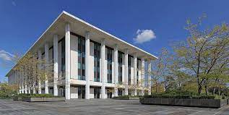
1968-70: Turning Points
National Library building opens –Film Division moves from Civic shop front to rear of 3rd floor
Cull of the nitrate collection
Ultimatum from FIAF
Enter the Senator….
Notes:
The National Library building opened in 1968 and all the scattered departments, including the Film Division, moved in. So did I. I began work there in December.
Some months later, as a new staff member, I had to participate in the arbitrary reduction of the nitrate collection. The storage bunker behind the Australian War Memorial was slated for demolition and the nitrate collection would eventually be evicted. Money had been found to copy about 400 reels, which could be destroyed after copying onto 16mm, removing – as was thought – the need for any future nitrate storage. Lacking any alternative, the rest would just have to go to the tip and the choice had to start now. As a new and ignorant recruit I felt extremely uneasy but in no position to argue against a policy decision already made by the Library. Film cans were passed along a human chain with a judgment made on the spot whether to keep it or throw it into the dump truck. In the end, 859 cans were put back in the bunker – much more than the expected 400. That left 1500 or so cans to go off to landfill, where they no doubt remain to this day.
Then the unexpected intervened. A severe letter arrived from FIAF, addressed to the National Librarian Harold White. It foreshadowed the National Library’s expulsion from FIAF unless it lifted its game. There was a pause while the nitrate collection stayed put. Out of the blue, a certain Senator Doug McClelland, who somehow knew a surprising amount about archival standards, raised the situation of the collection in Parliament. I has already been sent off to Sydney to find a new home for it.

Slide 11
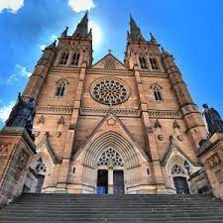
1970: A Moving Experience
Bunker obtained at the Government Munitions Filling Factory, St Marys
Transfer by road: the disappearing truck
Room to expand: no destruction after copying
Rapid growth: Commonwealth Film Unit, Efftee Studios collection
NO, NOT HERE
Notes:
I discovered the Government Munitions Filling Factory in the Sydney suburb of St Mary’s – contrary to rumour, St Mary’s Cathedral was not where the collection ended up!! The factory was happy to allocate an empty explosives bunker to the National Library and set up some second hand shelving in it. Like all previous stores, this one just kept the films out of the rain. There was no climate control. But there was room to grow, room to install basic items like a film rewind bench, and to finally start a proper inventory of the collection. By now nitrate reels were no longer being destroyed after copying.
In May 1970 the 859 cans were loaded onto a truck at the Australian War Memorial and sent off towards Sydney. And they failed to arrive. With a growing sense of panic we wondered whether there had been a conflagration along the way. It finally turned out that the truck had developed brake trouble and diverted to a garage for repairs. The garage manager was apprised of the fact that he was housing a cargo that could potentially incinerate his entire premises. No garage ever worked faster on fixing brakes.
The collection expanded quickly. Among other things, the Commonwealth Film Unit (later Film Australia) transferred its nitrate holdings. .Managing the collection meant regular visits to St Mary’s, of course, carrying bootfuls of nitrate back and forth in my car.

Slide 12
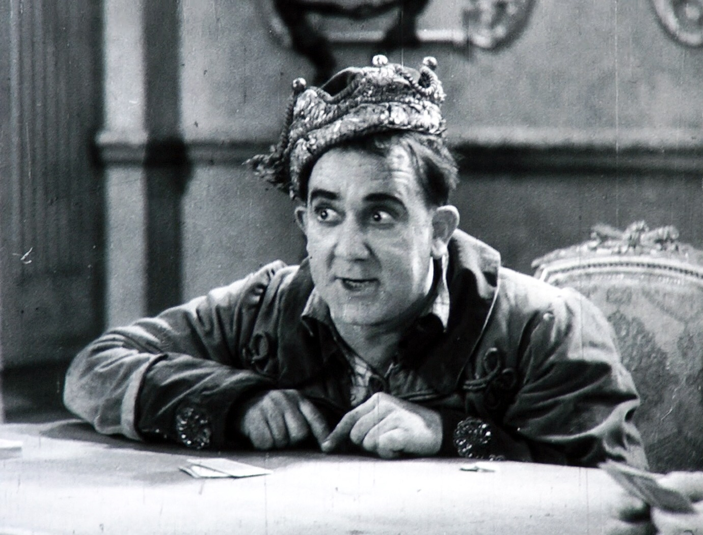
Efftee Studio 1931-34
Notes:
Around 1971, acting on information received, I sought out a man named Laurie Smith. He ran a clock shop called “The House of Time” in the Melbourne suburb of Richmond – a magical place where all the clocks chimed on the hour. His other passion was his nitrate film collection, which he kept where he lived, in the back rooms behind his shop. The jewels of his collection, which was arrayed in gleaming cans along several shelves, were the original negatives of the films produced by Melbourne’s Efftee Studio, during its short life from 1931 to 1934 – 8 feature films and numerous shorts. Laurie was a sick man with a bad heart, and he worried about the future of his collection. In the end, the National Library acquired it for a nominal sum.
The next time I visited Laurie he had lost the lease on his shop and was running his clock repair service from his home. He died soon after.
After the Cinesound heist, this was the other significant group of sound feature films in the nitrate era. Unlike the lost opportunities in the past to acquire the work of our major silent directors, we caught this one in time. The still is from His Royal Highness (1932), Australia’s first successful screen musical, which introduced comedian George Wallace to the screen.

Slide 13
The 1970s
Revival of the film industry
First dedicated staff unit for the film archive
Application of FIAF standards
Construction of Mitchell vault and final transfer of the collection from St Mary’s
Notes:
The 1970s was a time of great cultural change, including the revival of the film industry and the beginning of sustained use of archival footage in new film and television production. Another compilation film, The Pictures the Moved, soon followed. Its writer, Joan Long, would later become chair of the NFSA’s first Advisory Committee in 1984. The collection grew steadily. One significant acquisition was the collection of the late Harry Davidson, perhaps Melbourne’s best known film collector. His unique print of Metropolis (1927) would later be recognised as an icon in UNESCO’s “Memory of the World” program.
It was also a time when serious questions were starting to be raised about the suitability of the National Library as the continuing custodian of the archive. The first dedicated staff unit to manage the film archive was created in 1972, followed by a separate sound archive unit in 1974. Proper quality control of nitrate copying – still done by labs in Sydney and Melbourne – was finally possible. During 1973 I made a study trip of film archives overseas so that FIAF standards could be properly applied in our work, including returning nitrate copying to the 35mm standard.
Rod Wallace, by this time, was in charge of all of the National Library’s Special Collections, including Films. He had long lobbied for the construction of a proper climate controlled nitrate vault. When he retired in 1977 its construction in the industrial suburb of Mitchell had finally been approved, and of course that vault now belongs to the NFSA. The progressive transfer of the collection into its current home was completed by 1981

Slide 14
The Mitchell vault
Notes:
By this stage the collection had grown beyond the 12,000 can capacity of the vault so extra expedients – the installation of refrigerated shipping containers on the site – had to be resorted to. They are still there today.

Slide 15
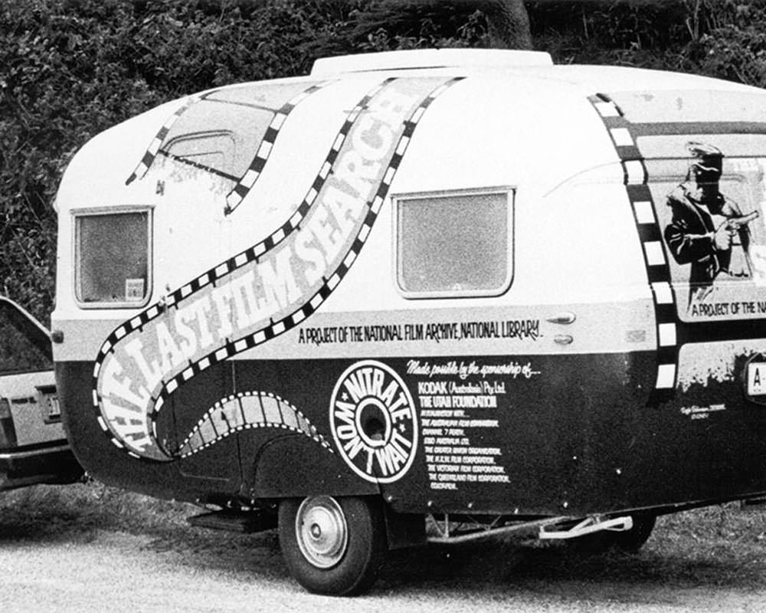
1981: The Last Film Search – nitrate won’t wait
A sense that we were running out of time…
A national treasure hunt
Finds included The Woman Suffers (1918) and The Story of the Kelly Gang (1906)
National Film and Sound Archive created in April 1984
Notes:
In the belief that we were running out of time to find the remaining nitrate film around Australia, we devised a search and rescue project and raised the commercial sponsorship to fund it. It turned out to have the unexpected benefit of enormously raising the public profile of our work. It involved having a field officer, Michael Cordell, on the road, touring the backblocks and checking places like abandoned picture theatres for forgotten films, while he was supported by a team back in Canberra arranging the logistics. It was, in a way, a national treasure hunt and that’s how the media perceived it. As part of the free publicity it attracted, I provided regular updates on television’s Mike Walsh Show, a national midday chat show with a huge audience.
Altogether, over its five year duration, the Search recovered about a million feet of film. This included the lost Longford/Lyell feature The Woman Suffers (1918) and a substantial fragment of The Story of the Kelly Gang (1906) – literally found on a rubbish tip. The father of NFSA staffer Anne Robb had already provided another fragment, a roll of negative which he had found in the debris of a demolished house in Melbourne. Michael Cordell’s one hour documentary film, The Last Film Search, is a brilliant encapsulation of the project. ….. The persistent question of the archive’s status as part of the National Library was finally resolved by the Government while the Search was still underway. In April 1984 the film and sound archives were separated from the National Library and reconfigured as the NFSA.

Slide 16
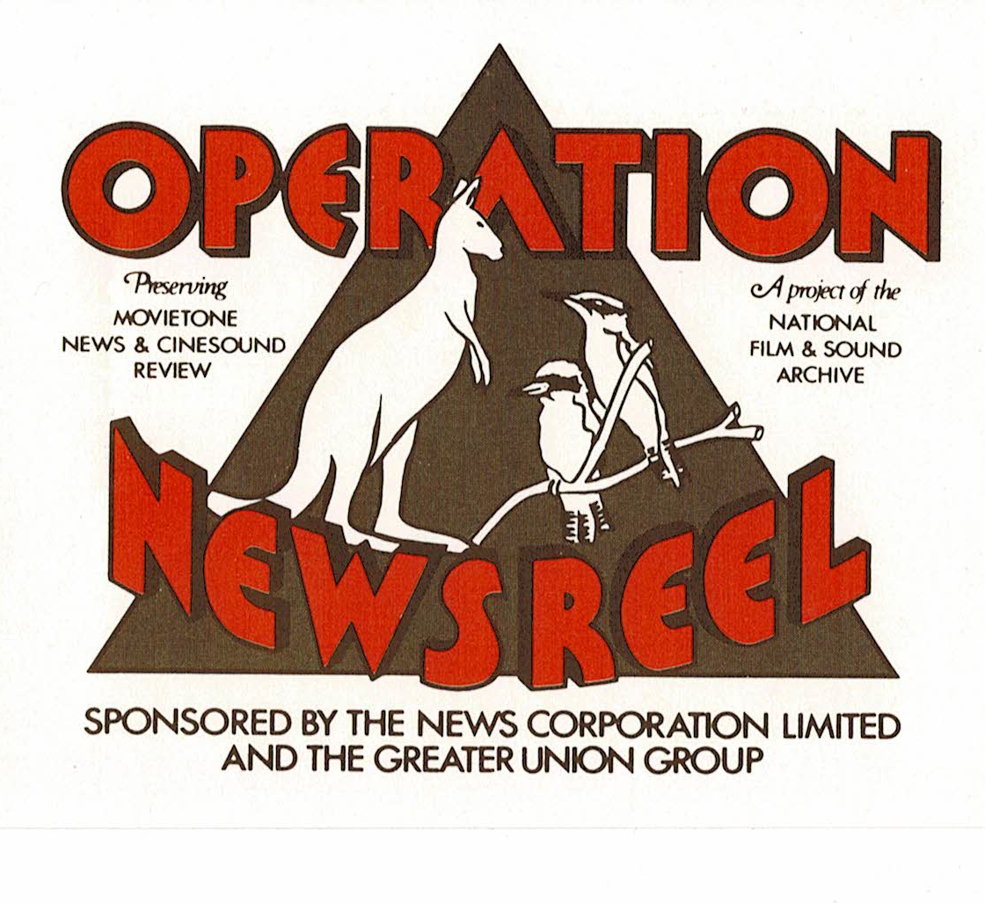
1988: Operation Newsreel
Notes:
After two years of negotiation, what I think stands as the NFSA’s largest corporately sponsored project was launched. Operation Newsreel aimed at preserving Australia’s surviving newsreel history, including the weekly issues of Cinesound Review and Australian Movietone News from 1931 to 1970, and was funded to the extent of $4 million by the parent companies of the two reels - News Corporation and the Greater Union Organisation.
They not only provided the money for the five year project, but donated the film library itself. It included around 1500 cans of nitrate, much of it original negative. The project was jointly launched by Prime Minister Bob Hawke and Rupert Murdoch on 23 September 1988.
As part of the project, the NFSA and students at the Australian Film, Television and Radio School produced The Last Newsreel – in 35mm black and white, it was officially Australia’s last newsreel. It received a national theatrical release.

Slide 17
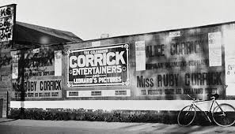
1991-93: Contraction
Closure of access
Accessioning of backlogs
Repatriation
Policy mindset
Keeping the Corrick collection
Notes:
In 1991, following a risk management survey of the collection, the NFSA entered a two year period during which all access services were suspended and staff were redeployed to accession the huge accumulated backlogs of collection material. This had both good and bad consequences: it brought most of the collection under control in the new MAVIS computer system and eliminated unnecessary duplication, but it was also politically disastrous. An inaccessible archive is a contradiction in terms. The NFSA was becoming forgotten by the public and in danger of being forgotten by the government.
This project also isolated the NFSA from its stakeholders and had a serious effect on its intellectual and policy mindset, by encouraging a fervently simplistic focus on keeping “Australian” material and eliminating “overseas” materials even if they were part of formed collections. As the project proceeded, hundreds of nitrate reels of American and European films were repatriated to archives overseas, where, of course, they were welcomed. Yet, at they same time, these prints and their histories – some going back to the 1910s and earlier - were contextually part of Australian’s audiovisual heritage as well, and they were now lost to us. I had to personally intervene to stop the Corrick collection being split up and dispersed; I was less successful in trying to keep the Harry Davidson collection intact.

Slide 18
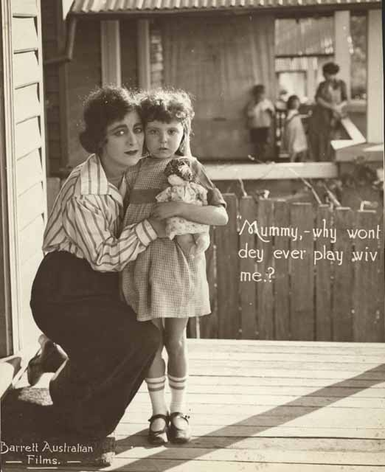
What’s in the nitrate collection now?
Notes:
Put the term “nitrate” into the NFSA’s film collection search window and you’ll come up with over 9000 titles. They won’t all be nitrate films – some will be triacetate copies made from nitrate originals , some will be films with the word ‘nitrate’ in the title, some won’t be rolls of film but simply a strip of a few frames from an otherwise lost film. But you can relax with a cup of coffee and scroll through and take a fascinating journey through the nitrate years. The largest groups of surviving films will include the Cinesound features, shorts and newsreels; the Efftee collection; the government documentaries (Cinema Branch, DOI Film Unit) and then onto smaller holdings such as the Corrick collection. In the silent years, up to about 1930, it’s individual titles, often incomplete or fragmentary: a rough estimate is that only about 5% of Australian productions from that time survives either on nitrate or as acetate copies. Once we enter the sound era of the 40s and 50s the survival rate is dramatically better although there are still plenty of gaps.
The still is from Franklyn Barrett’s last feature “Know Thy Child” 1922 – a lost film, like most of Barrett’s work..

Slide 19
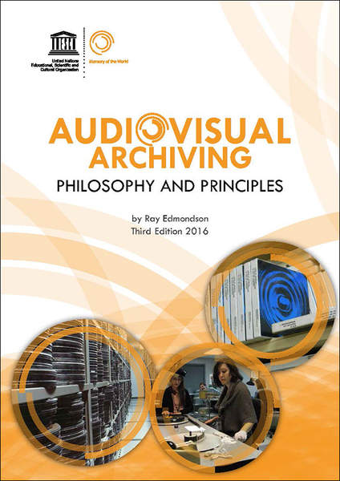
1994-2001 Reflections
Retained nitrate now sometimes in better shape than the acetate copies made from it.
Appreciation of the value of the original artefact
No copy can precisely duplicate the optical qualities of base and emulsion.
Notes:
Of course the collection resumed its growth afterwards. My direct contact with it ended in 2001, when I retired from the NFSA, so I won’t go past that date.
In 1998 I came to write the first edition of my book for UNESCO, Audiovisual Archiving: Philosophy and Principles. In it I was able to codify a number of things that I, and my collaborators in the profession, had learned over many years of exposure to nitrate film.
Properly managed, nitrate film lasts longer than anyone had previously imagined at the time of projects like the Last Film Search. In some cases it has outlasted the triacetate preservation copies made from it.
No copy can precisely duplicate the optical qualities of both the nitrate base and pre-1951 emulsions and colour systems. This is why projection festivals such as the Nitrate Picture Show at George Eastman Museum are so important now, allowing these qualities to be experienced first hand.
Every nitrate reel is an artefact with a story, and the information it carries is more than just the image and sound content – that’s a good topic for discussion! So if you have the opportunity to wind through – and smell! – a nitrate reel, enjoy its beauty and ambience!

Slide 20
Sources
Rod Wallace: The Film Division – Past, Present and Future June, 1970
The Last Newsreel https://www.collection.nfsa.gov.au/title/53323
The Last Film Search https://www.collection.nfsa.gov.au/title/8017
The Pictures that Moved https://shop.nfsa.gov.au/history-of-australian-cinema-pictures-that-moved-t
Anthony Buckley: Behind a Velvet Light Trap https://www.buckleyfilms.com.au/buckley_biography.html
Anthony Buckley: Forgotten Cinema https://www.acmi.net.au/works/67734--forgotten-cinema/
Ray Edmondson thesis: National Film and Sound Archive: The quest for identity Link here
Audiovisual Archiving: Philosophy and Principles Link principles

